Slide 1


University Institute of Engineering
DEPARTMENT OF COMPUTER SCIENCE & ENGINEERING
Bachelor of Engineering (Computer Science & Engineering)
Subject Name:Computer Networks
Subject Code: CSH-312/ ITH-312
DISCOVER . LEARN . EMPOWER

Slide 2
Data Link Layer

Slide 3
Data Link Layer Design Issues
Services Provided to the Network Layer
Framing
Error Control
Flow Control

Slide 4
Functions of the Data Link Layer
Provide service interface to the network layer
Dealing with transmission errors
Regulating data flow

Slide 5
Encapsulation
De-capsulation
Process of encapsulating one protocol into other protocol
Process of de- capsulating one protocol into other protocol

Slide 6
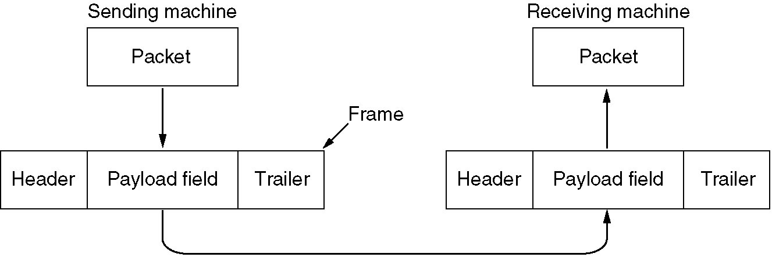
Functions of the Data Link Layer (2)
Relationship between packets and frames.

Slide 7
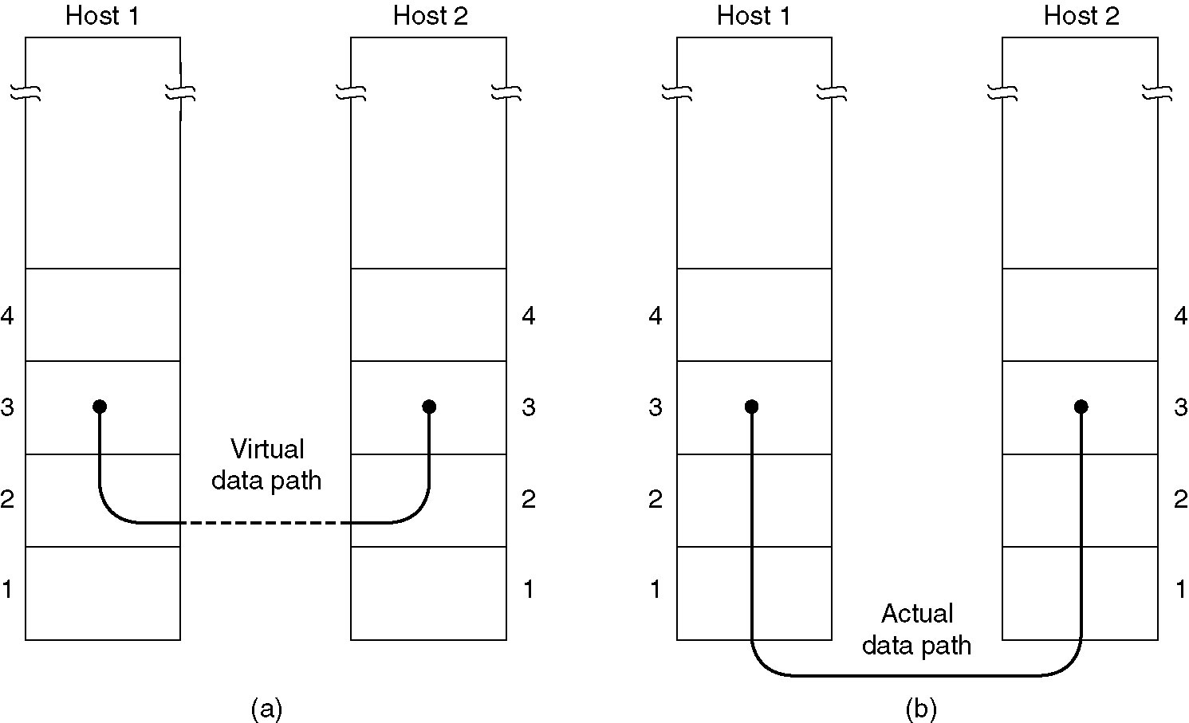
Services Provided to Network Layer
(a) Virtual communication.
(b) Actual communication.

Slide 8
The data link layer can be designed to offer various services
Unacknowledged connectionless service.
Acknowledged connectionless service.
Acknowledged connection-oriented service
Unacknowledged connectionless service consists of having the source machine send independent frames to the destination machine without having the destination machine acknowledge them.
No logical connection is established beforehand or released afterward.

Slide 9
This class of service is appropriate when the error rate is very low so that recovery is left to higher layers. It is also appropriate for real-time traffic, such as voice.
The next step up in terms of reliability is acknowledged connectionless service.
When this service is offered, there are still no logical connections used, but each frame sent is individually acknowledged.
In this way, the sender knows whether a frame has arrived correctly. If it has not arrived within a specified time interval, it can be sent again.

Slide 10
When connection-oriented service is used, transfers go through three distinct phases.
In the first phase, the connection is established by having both sides initialize variables and counters needed to keep track of which frames have been received and which ones have not.
In the second phase, one or more frames are actually transmitted.
In the third and final phase, the connection is released, freeing up the variables, buffers, and other resources used to maintain the connection

Slide 11
The usual approach is for the data link layer to break the bit stream up into discrete frames and compute the checksum for each frame.
When a frame arrives at the destination, the checksum is recomputed.
If the newly-computed checksum is different from the one contained in the frame, the data link layer knows that an error has occurred and takes steps to deal with it (e.g., discarding the bad frame and possibly also sending back an error report).

Slide 12
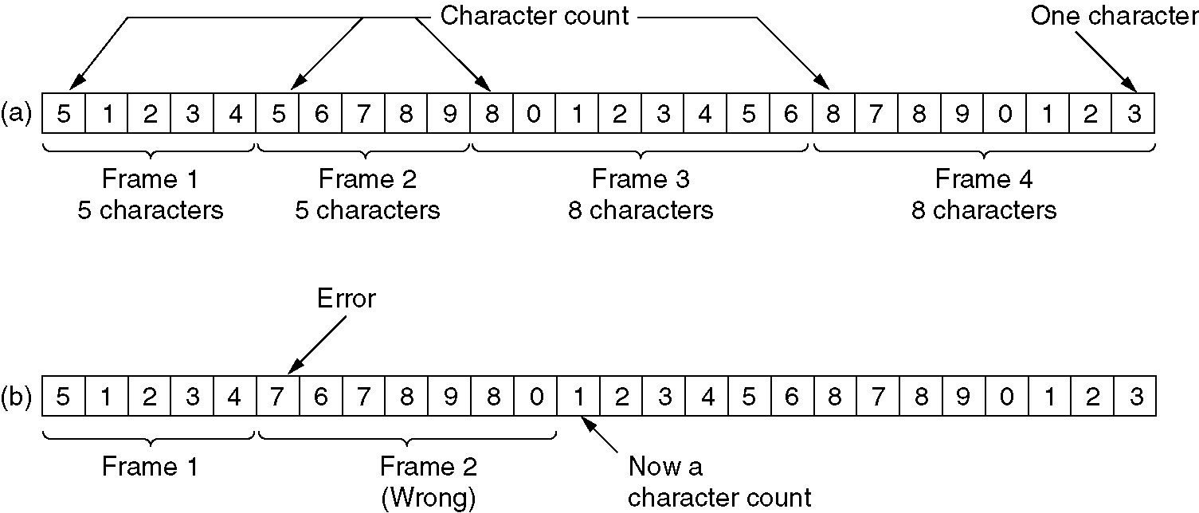
Framing
A character stream. (a) Without errors. (b) With one error.

Slide 13
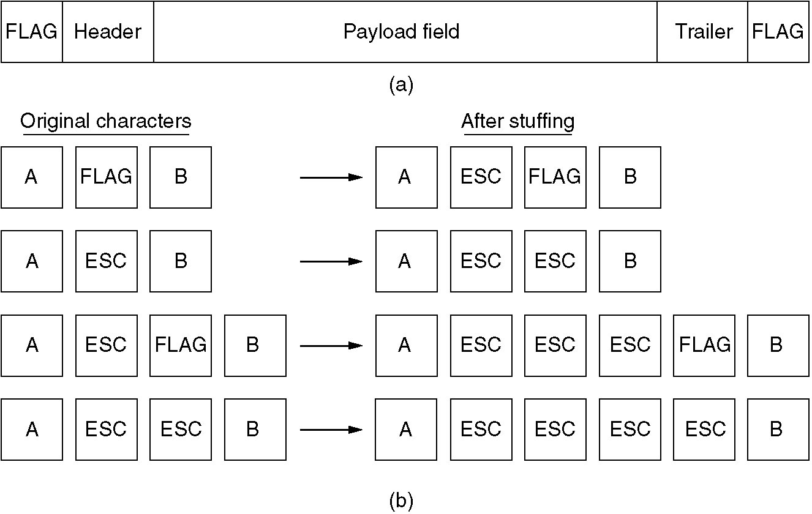
Framing (2)
(a) A frame delimited by flag bytes.
(b) Four examples of byte sequences before and after stuffing.

Slide 14
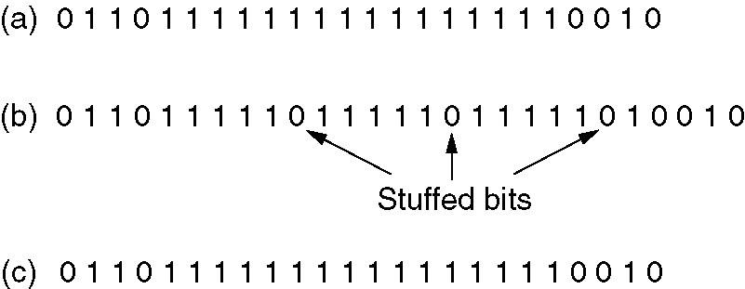
Framing (3)
Bit stuffing
(a) The original data.
(b) The data as they appear on the line.
(c) The data as they are stored in receiver’s memory after destuffing.

Slide 15
The following character encoding is used in a data link protocol: A: 01000111; B: 11100011; FLAG: 01111110; ESC: 11100000 Show the bit sequence transmitted (in binary) for the four-character frame: A B ESC FLAG when each of the following framing methods are used:
(a) Character count.
(b) Flag bytes with byte stuffing.
(c) Starting and ending flag bytes, with bit stuffing.

Slide 16
(a) 00000101 01000111 11100011 11100000 01111110
(b) 01111110 01000111 11100011 11100000 11100000 11100000 01111110 01111110
(c) 01111110 01000111 110100011 111000000 011111010 01111110

Slide 17
The following data fragment occurs in the middle of a data stream for which the byte-stuffing algorithm described in the text is used: A B ESC C ESC FLAG FLAG D. What is the output after stuffing?
A bit string, 0111101111101111110, needs to be transmitted at the data link layer. What is the string actually transmitted after bit stuffing?

Slide 18
Error Correction
It can be handled in two ways:
receiver can have the sender retransmit the entire data unit.
The receiver can use an error-correcting code, which automatically corrects certain errors.

Slide 19
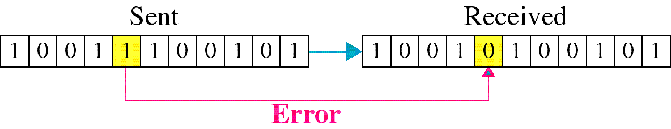
Single-bit error

Slide 20
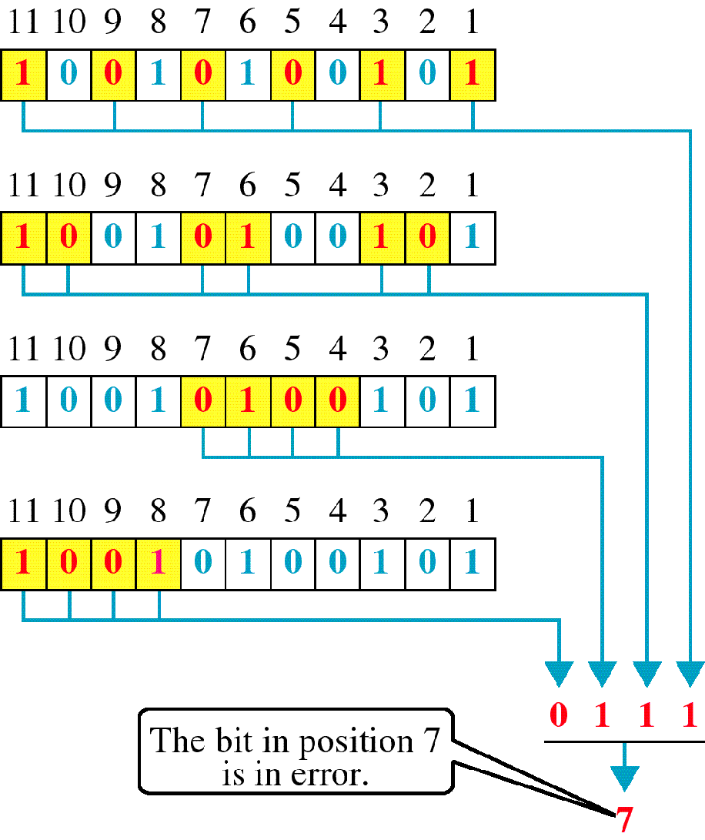
Error
Detection

Slide 21
Basic concepts
Networks must be able to transfer data from one device to another with complete accuracy.
Data can be corrupted during transmission.
For reliable communication, errors must be detected and corrected.
Error detection and correction are implemented either at the data link layer or the transport layer of the OSI model.

Slide 22
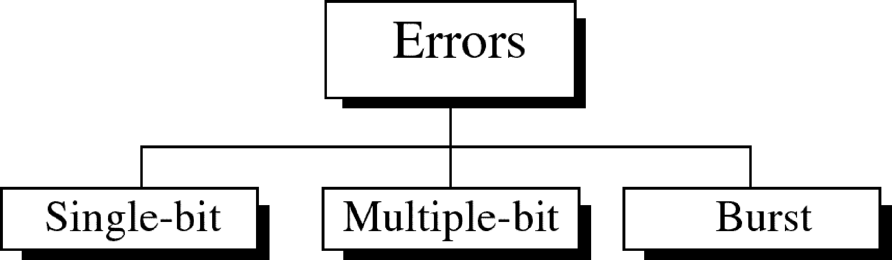
Types of Errors

Slide 23
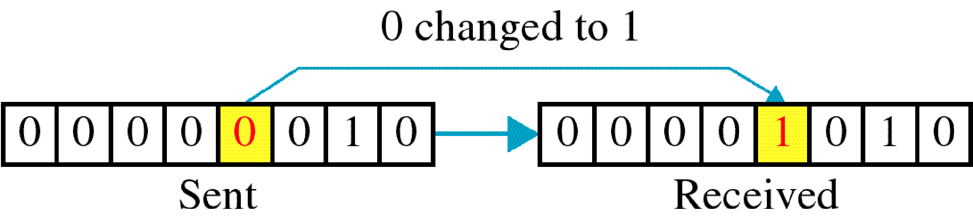
Single-bit error

Slide 24
Single bit errors are the least likely type of errors in serial data transmission because the noise must have a very short duration which is very rare. However this kind of errors can happen in parallel transmission.
Example:
If data is sent at 1Mbps then each bit lasts only 1/1,000,000 sec. or 1 μs.
For a single-bit error to occur, the noise must have a duration of only 1 μs, which is very rare.

Slide 25
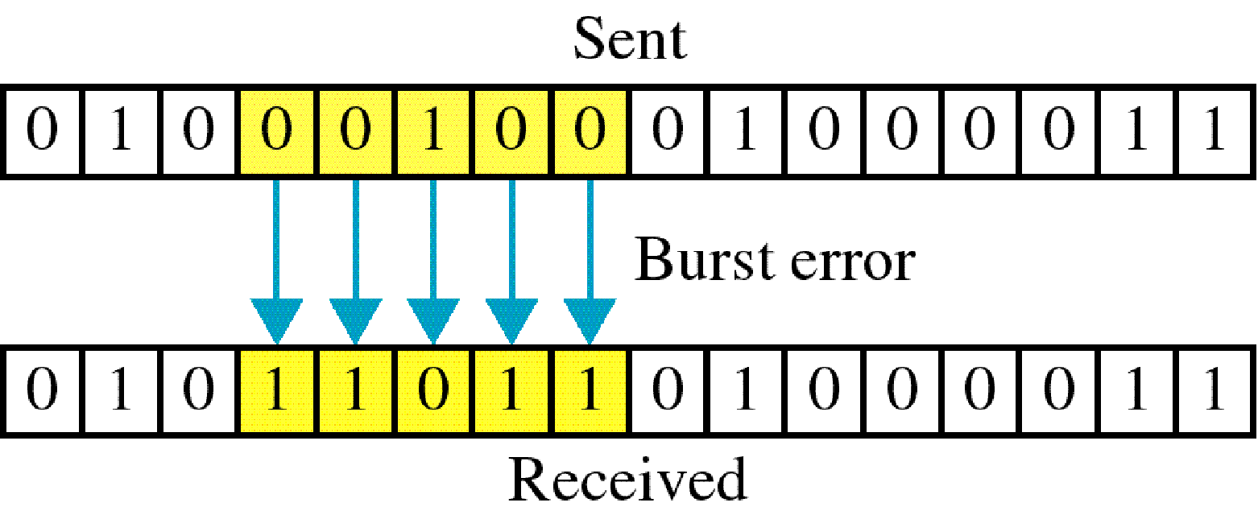
Burst error

Slide 26
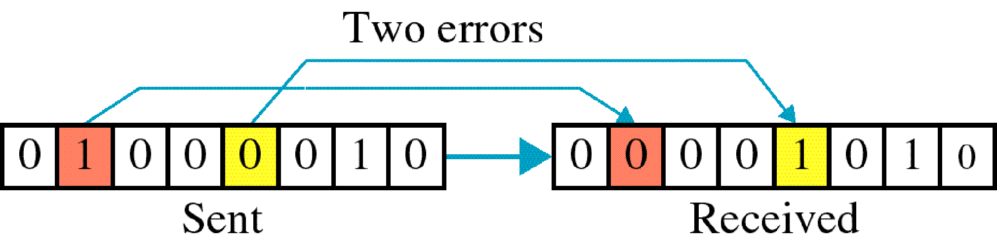

Slide 27
The term burst error means that two or more bits in the data unit have changed from 1 to 0 or from 0 to 1.
Burst errors does not necessarily mean that the errors occur in consecutive bits, the length of the burst is measured from the first corrupted bit to the last corrupted bit. Some bits in between may not have been corrupted.

Slide 28
Burst error is most likely to happen in serial transmission since the duration of noise is normally longer than the duration of a bit.
The number of bits affected depends on the data rate and duration of noise.
Example:
If data is sent at rate = 1Kbps then a noise of 1/100 sec can affect 10 bits.(1/100*1000)
If same data is sent at rate = 1Mbps then a noise of 1/100 sec can affect 10,000 bits.(1/100*10⁶)

Slide 29
Error detection
Error detection means to decide whether the received data is correct or not without having a copy of the original message.
Error detection uses the concept of redundancy, which means adding extra bits for detecting errors at the destination.
Notes:
Make sense of message.
Make sense of message.

Slide 30
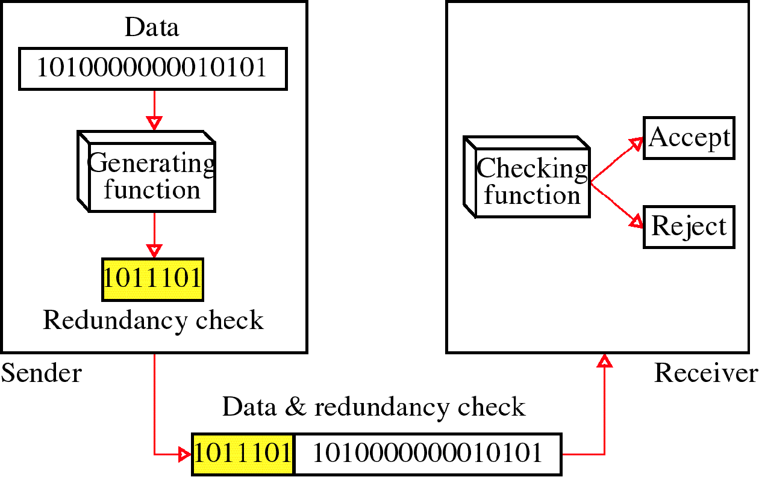
Redundancy

Slide 31
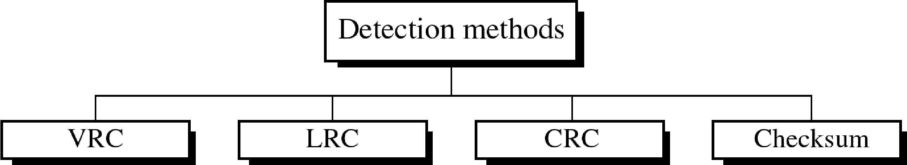
Four types of redundancy checks are used
in data communications

Slide 32
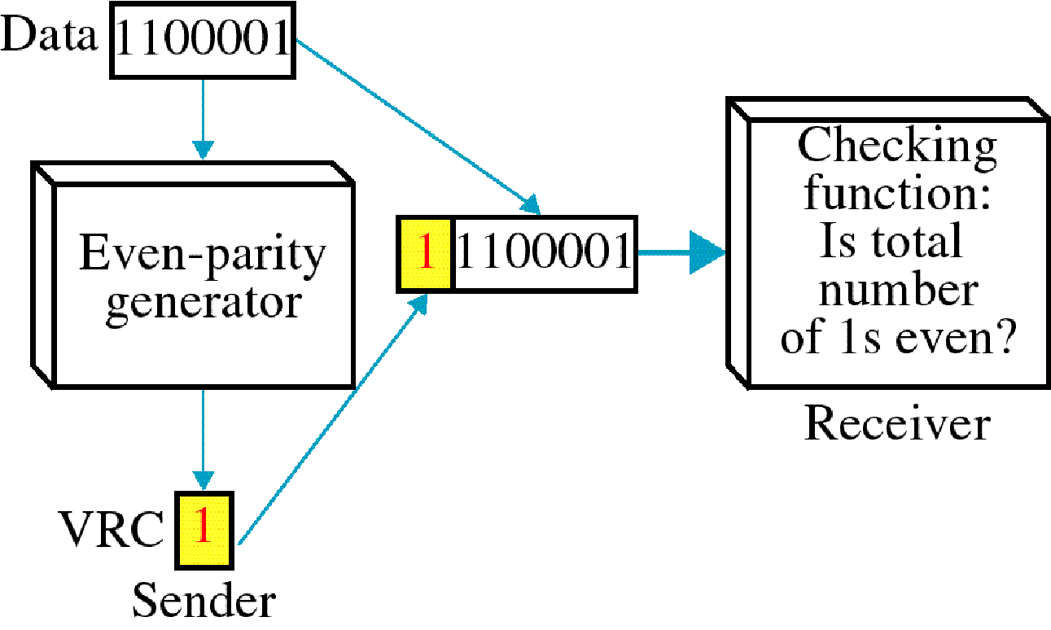
Vertical Redundancy Check
VRC

Slide 33
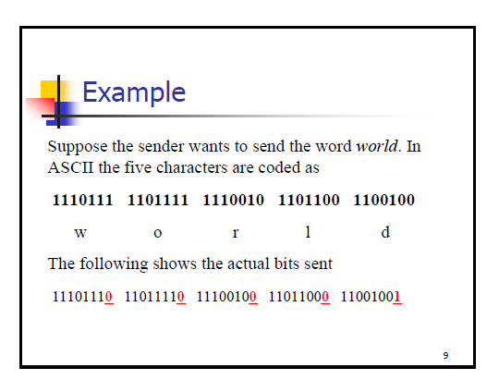

Slide 34
Performance
It can detect burst errors only if the total number of errors is odd.

Slide 35
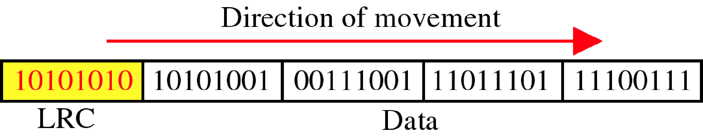
Longitudinal Redundancy Check
LRC

Slide 36
Performance
LRC increases the likelihood of detecting burst errors.
If two bits in one data units are damaged and two bits in exactly the same positions in another data unit are also damaged, the LRC checker will not detect an error.

Slide 37
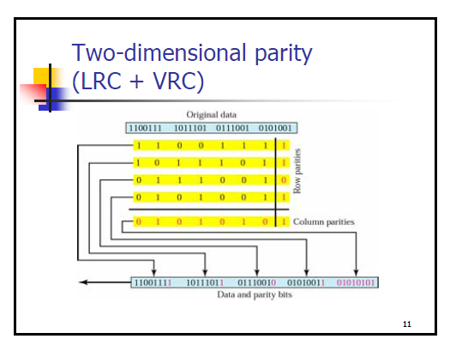

Slide 38
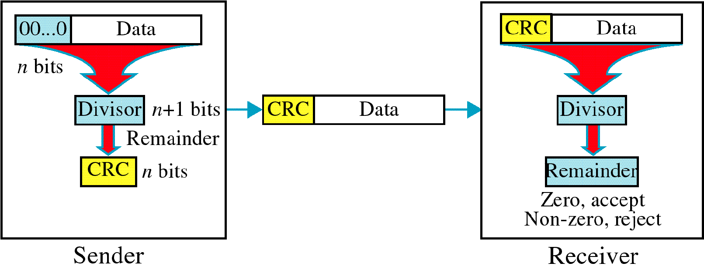
Cyclic Redundancy Check
CRC

Slide 39
Cyclic Redundancy Check
Given a k-bit frame or message, the transmitter generates an n-bit sequence, known as a frame check sequence (FCS), so that the resulting frame, consisting of (k+n) bits, is exactly divisible by some predetermined number.
The receiver then divides the incoming frame by the same number and, if there is no remainder, assumes that there was no error.

Slide 40
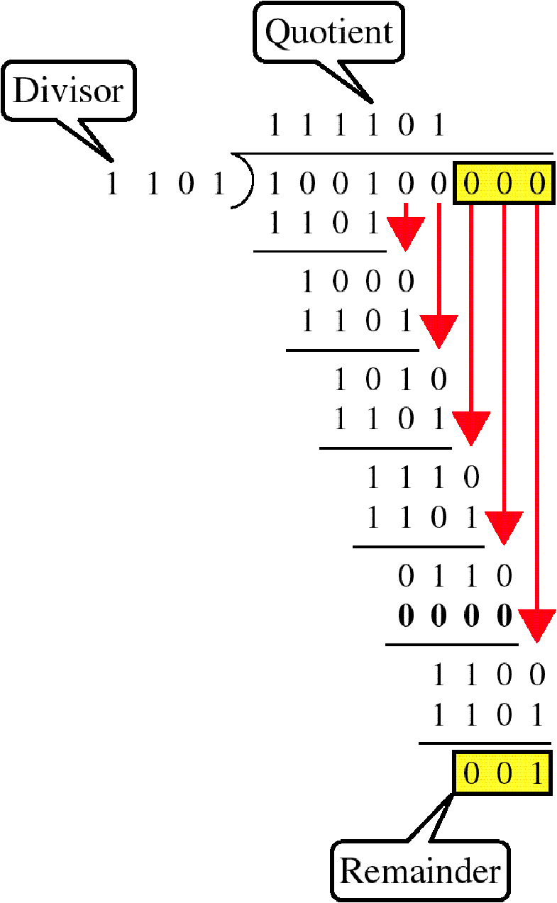
Binary Division

Slide 41
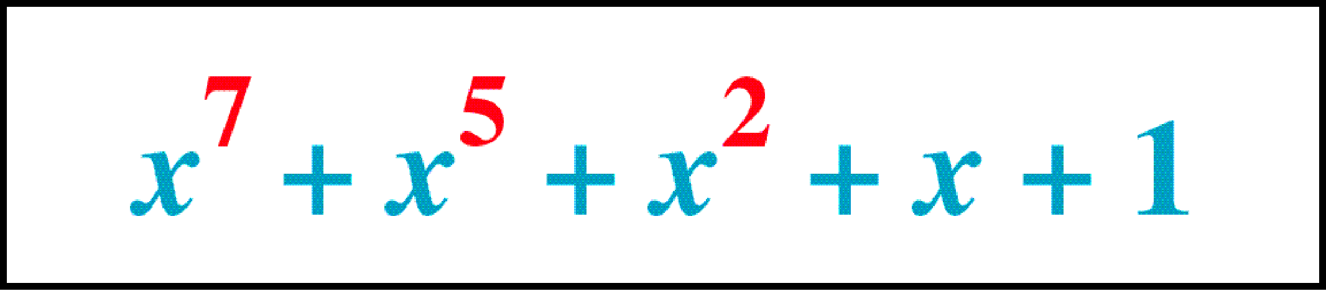
Polynomial

Slide 42
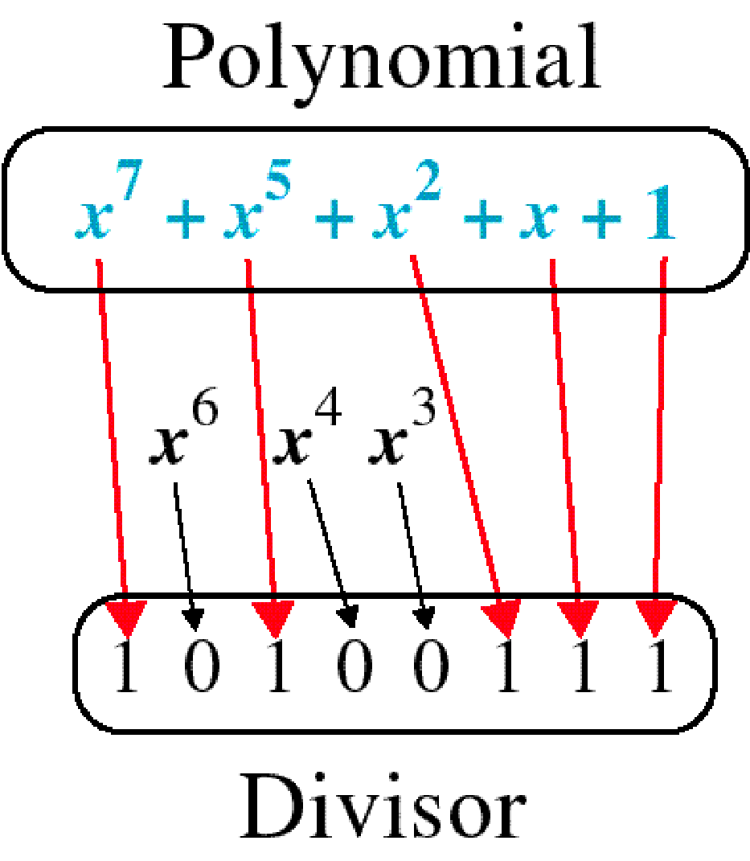
Polynomial and Divisor

Slide 43
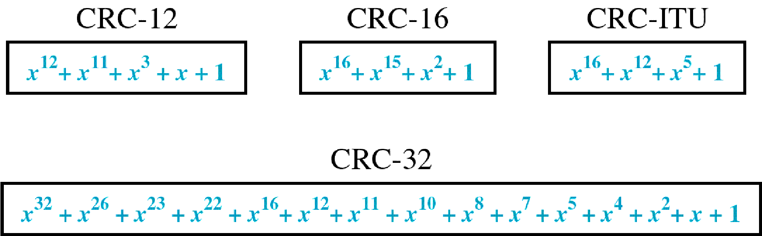
Standard Polynomials

Slide 44
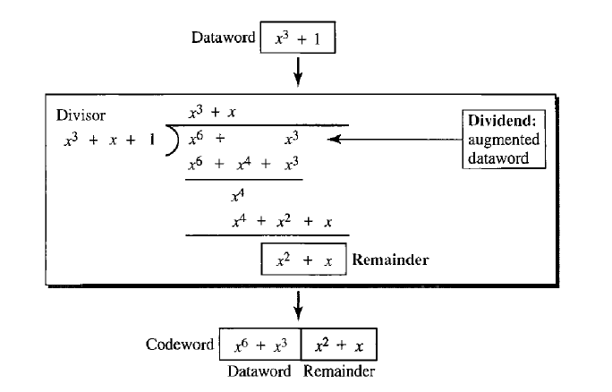

Slide 45
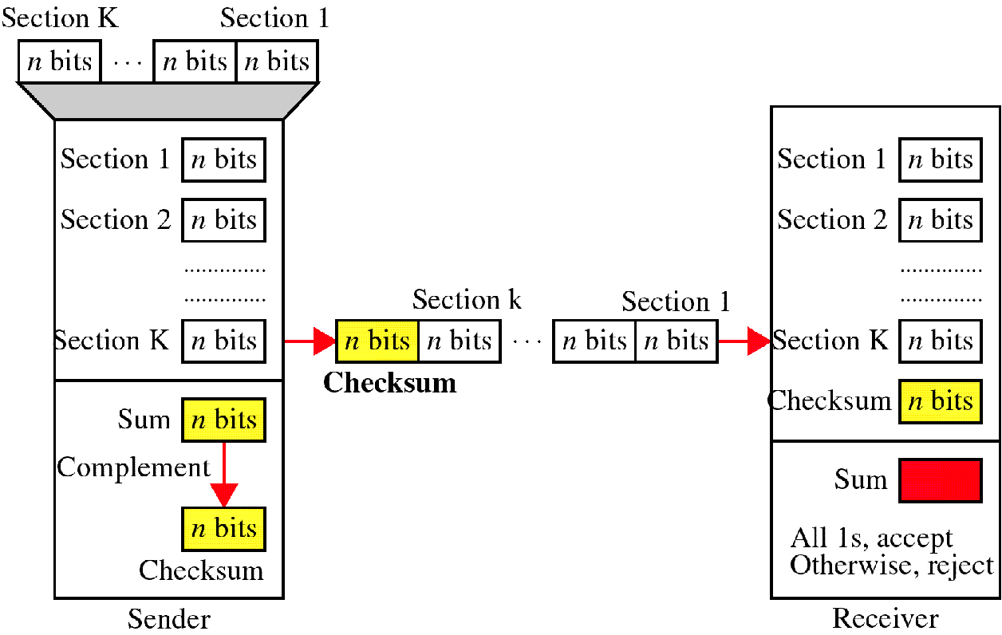
Checksum

Slide 47
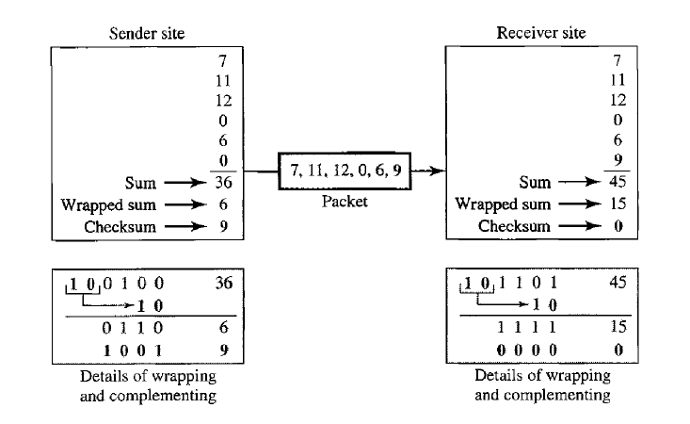

Slide 48
At the sender
The unit is divided into k sections, each of n bits.
All sections are added together using one’s complement to get the sum.
The sum is complemented and becomes the checksum.
The checksum is sent with the data

Slide 49
At the receiver
The unit is divided into k sections, each of n bits.
All sections are added together using one’s complement to get the sum.
The sum is complemented.
If the result is zero, the data are accepted: otherwise, they are rejected.

Slide 50
Performance
The checksum detects all errors involving an odd number of bits.
It detects most errors involving an even number of bits.
If one or more bits of a segment are damaged and the corresponding bit or bits of opposite value in a second segment are also damaged, the sums of those columns will not change and the receiver will not detect a problem.

Slide 51
Error Correction
It can be handled in two ways:
receiver can have the sender retransmit the entire data unit.
The receiver can use an error-correcting code, which automatically corrects certain errors.

Slide 52
Single-bit error correction
To correct an error, the receiver reverses the value of the altered bit. To do so, it must know which bit is in error.
Number of redundancy bits needed
Let data bits = m
Redundancy bits = r
∴Total message sent = m+r
The value of r must satisfy the following relation:
2^{r} ≥ m+r+1

Slide 53
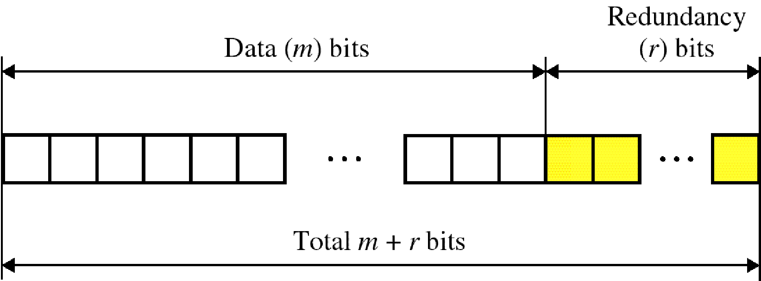
Error Correction

Slide 54
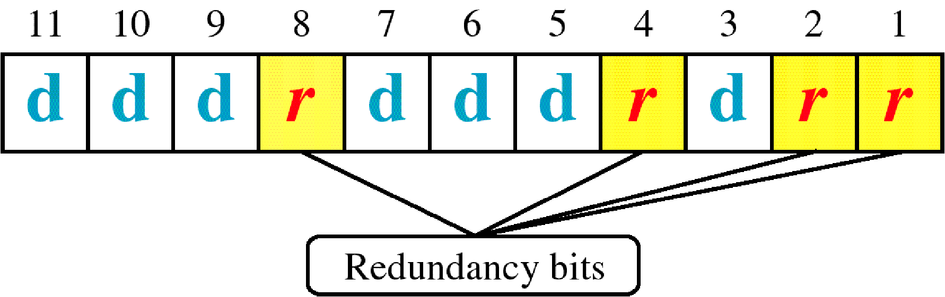
Hamming Code

Slide 55
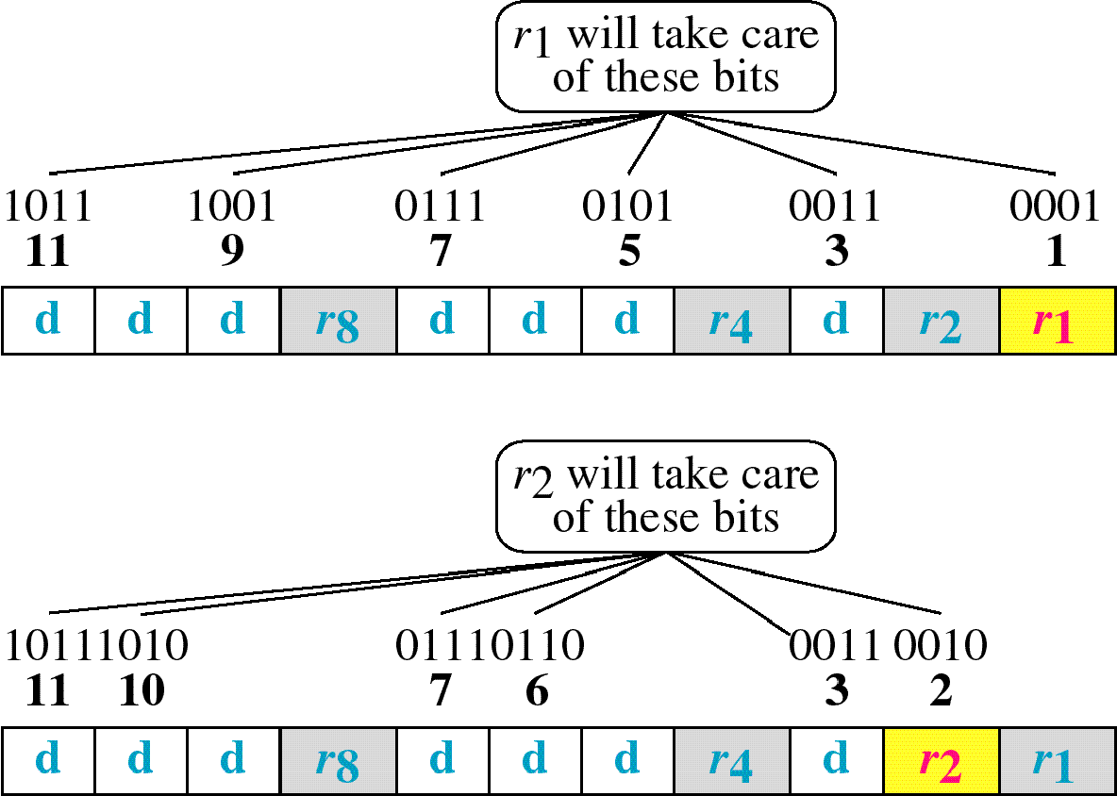
Hamming Code

Slide 56
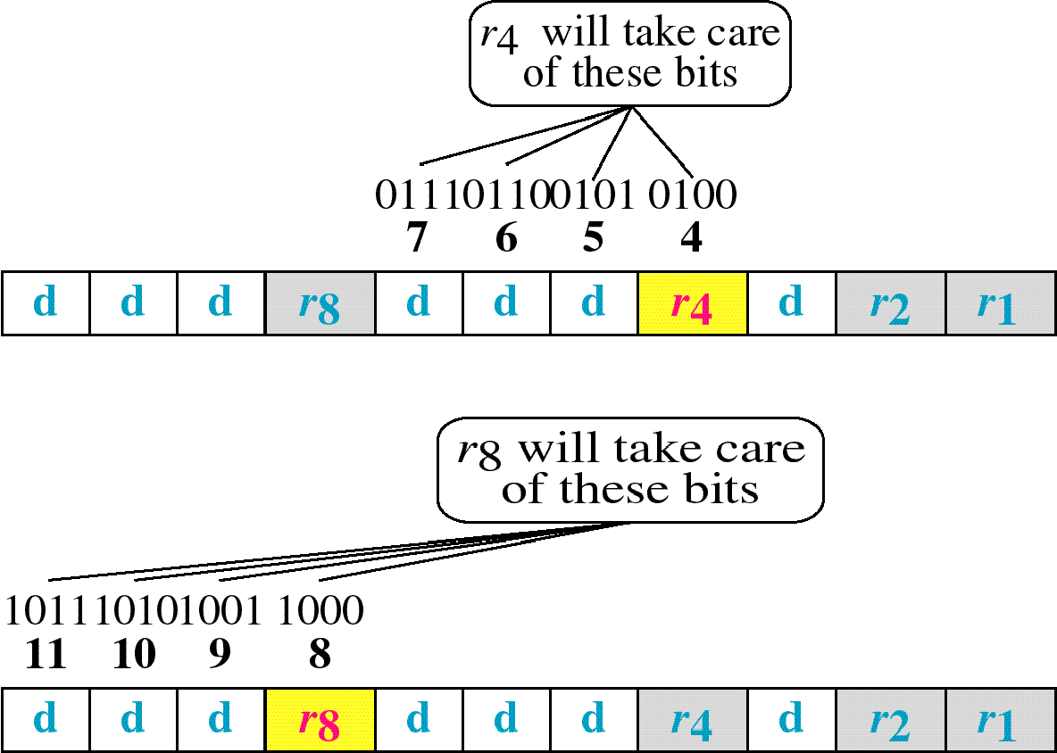
Hamming Code

Slide 57
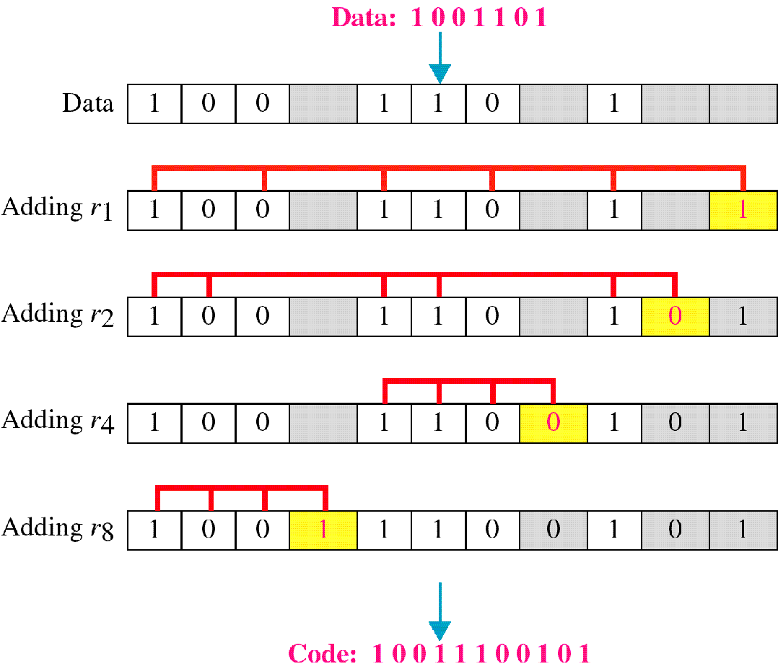
Example of Hamming Code

Slide 58
Single-bit error

Slide 59
Error
Detection

Slide 60
References
http://highered.mheducation.com/sites/0072967757/student_view0/chapter11/index.html
https://www.tutorialspoint.com/data_communication_computer_network/error_detection_and_correction.htm
Data Communications and Networking by Behrouz A. Forouzan
www.mhhe.com/Forouzan

